Slide 1

WordPress Theme Development
Research topic. Web Programming. Assignment-2
Mohan Kumar

Slide 2
Student name(s) Mohan Kumar
Student ID(s) 19493389
Course code | COMP606
Course Title | Web Programming
Tutor name | Sue Beale
Assignment | 2 –Investigation & Implementation Research Project
Due Date | Week 13
Date Submitted 26/05/2020
Case Study WordPress Theme Development

Slide 3

Introduction to WordPress Theme
In WordPress, a theme is a collection of templates and stylesheets used to define the appearance and display of a WordPress powered website.
The website can be modified by adding plugins or by adding code to the functions.php file. Themes generally consists of three parts in addition to images and JavaScript files. The three parts are the style.css file, the WordPress template files, and an optional functions.php file that will allow changes to be made to the theme.

Slide 4
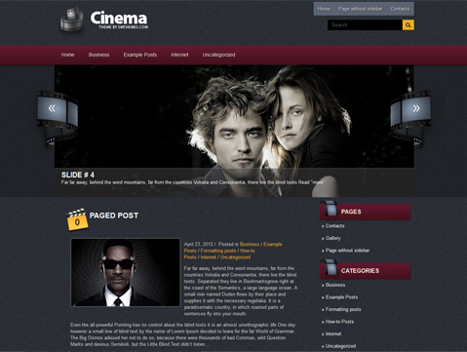
How can we use WordPress Theme?
Websites can be built from scratch or by using existing templates and platforms like WordPress.
WordPress Themes consists of design, home page, menus, blog section, forms etc., so that there’s no need to develop all these sections from scratch.
No Technical knowledge is required to use WordPress Themes. All we need is a hosting plan and we can pick available themes suitable for our website.

Slide 5
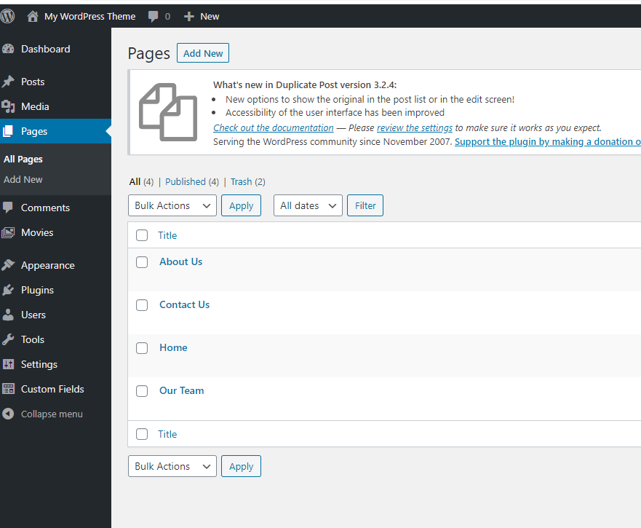
Customization of web pages
We can create as many pages as we want and customize them.
Images, links, headings and paragraphs etc., can be added to the webpage easily.

Slide 6
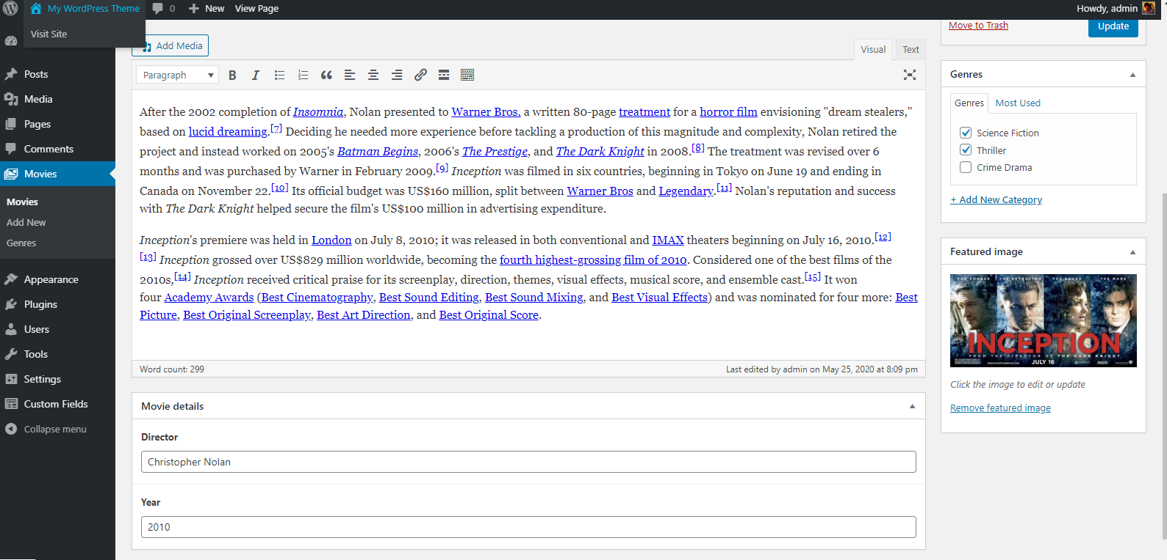
Add products to the website within minutes!
Products can be added to the website easily with the help of predesigned theme.
They can be categorized, and we can also add features of each product without developing the code multiple times.

Slide 7
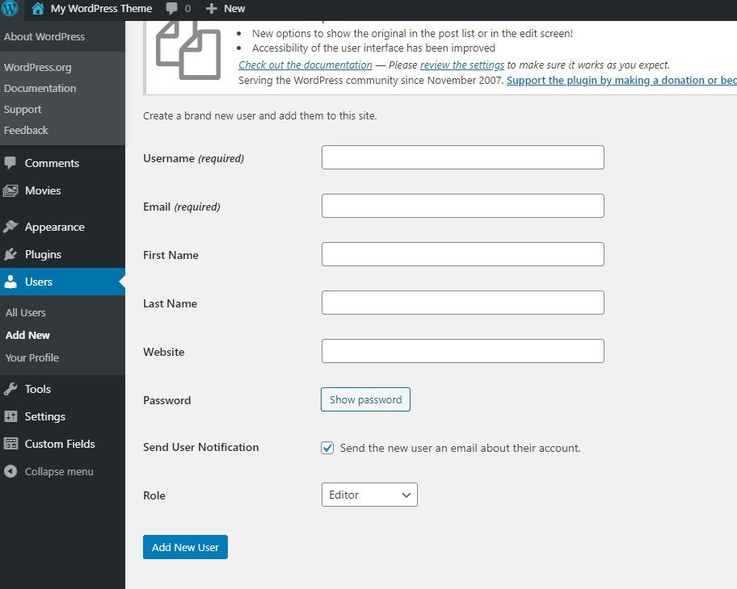
Access to team members
Each person in a team has specific designation and based on their designation, the access to specific parts of website can be restricted by using WordPress Theme.
Administrator can create as many users (like Editor, Author) as he want and give their designation and required access to the content of the website.
All this work can be done easily, and lot of time can be saved by avoiding the coding part.

Slide 8
Advantages/Likes & Disadvantages/Dislikes
Reduced Upfront Investment
Faster to Implement
Mobile Friendly
Industry Specific Themes
No Technical Support
Bugs
Pirated and Hacked Templates
Market Competition

Slide 9
My Opinion on this Technology
Considering the advantages and disadvantages of WordPress Themes, I believe the that prebuilt themes can be useful for specific websites like Cinema reviews, personal blogs, photography websites, free tutorial websites like cooking.
On the other hand, I think it’s not very safe for websites which has payment sections or any News websites etc., as there is a chance of being hacked or facing bugs because of the improper design of the theme.

Slide 10
Thank you
Mohan Kumar

